Slide 1
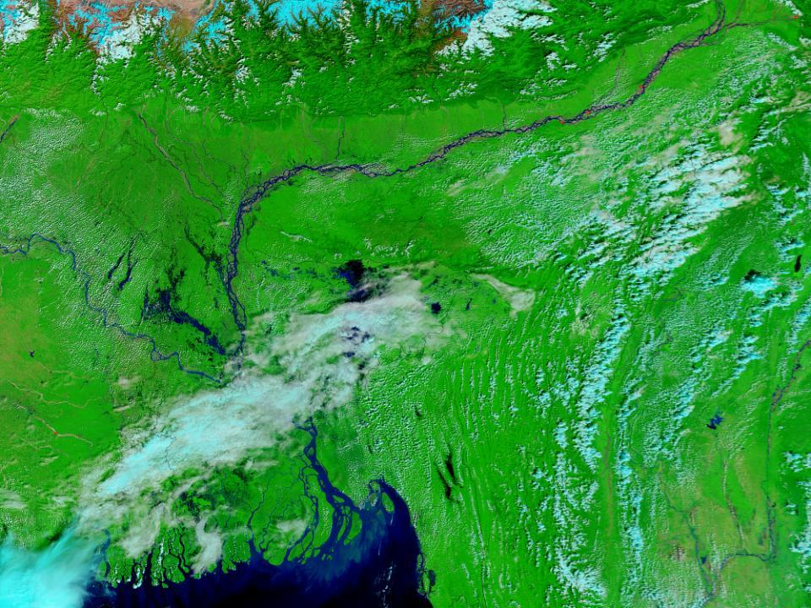
“
Climate Change and Population Movements in Bangladesh: Knowledge Gaps
Peter Kim Streatfield, ICDDR,B
Nansen Initiative
Khulna 3 April 2015

Slide 2
Salinity
Measured occasionally by Ministry of Agriculture (1973, 2000, 2009)
Need more frequent measurements – soil & water
Salinity moves inland (north) in dry season, and south towards Bay of Bengal as monsoon washes it out.
Widespread land damage has occurred due to salinity - many crops no longer grow.
Notes:
Salinity: this is measured periodically by WAPDA, but not known yet where, or how frequently, or how accurately. It is known that during periods when river flows are low (dry season) that salinity levels have risen as far as 200 kms. inland of the Bay of Bengal.
This should be added to relevant ICDDR,B fieldsites.
Acceptable range is ?? Range which may cause obvious hypertension is ??
Hypertension: if salinity causes hypertension, how will this be detected? Reports from the Health MIS system reporting patients at district, Upazila and union facilities? Is it sufficient, Is it comprehensive? Is it sensitive enough to detect upward trends, consistent with increasing salinity? Probably need surveillance, or periodic surveys in the vulnerable areas.

Slide 3
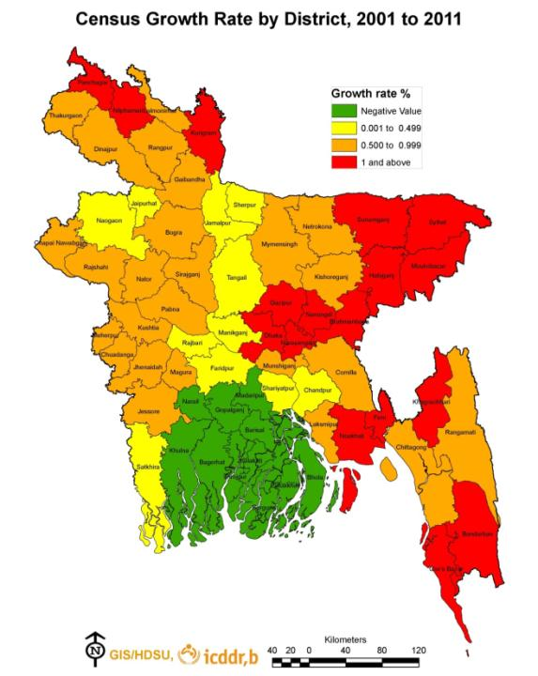
Migration within Bangladesh is partly driven by ecological change reducing agricultural production
Between 2001 & 2011, zero population growth in Barisal Division (green area), and little in Khulna, due to outmigration.
Many of these people living in slums in Dhaka

Slide 4
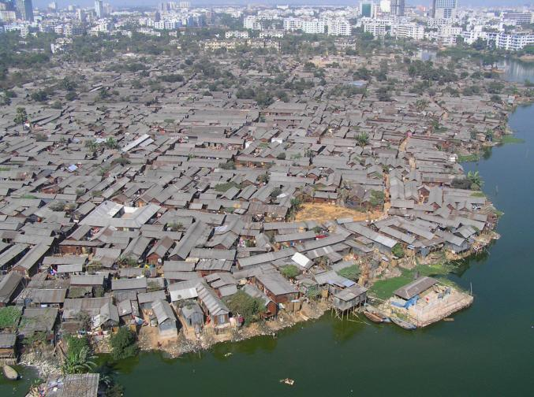
Slums: One third of City Corporations now,
but growing twice as fast as non-slums
Population densities vary greatly:
Rural = 800/km²;
Urban = 24,000/km²;
Slums=205,000/km².
CUS, 2005
These high population densities have major implications for health

Slide 5
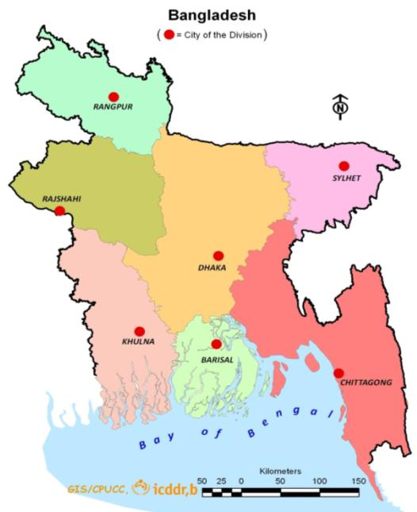
Place of Origin of Current Female Residents of Dhaka City Slums
Half of women in Dhaka City Corporation slums are from Dhaka Division
20% of Dhaka slum women are from Barisal
Few are from western Divisions or from Sylhet
6%
Dhaka Rural
1%
4%
25%
25% Dhaka City
4%
20%
10%

Slide 6
Place of Origin of Current Female Residents of Chittagong City Slums
Over two-thirds of women in Chittagong city slums are from the same Division
Nine% are from Barisal and 7% from Dhaka
Migrants from western Divisions bypass Dhaka to settle in Chittagong slums
6%
2%
1%
7%
Chittagong Rural
3%
9%
30%
38%
Chittagong City

Slide 7
Men are most likely to migrate to look for work; women are most likely to migrate to join family

Slide 9
In a 3 country study of adaptation, we are following ecological migrants who have lost their villages beside the Meghna River in Matlab. Some move to the CHT – there is a new village called Matlab. May contribute to bringing malaria down to lowlands again. Some move to the cities. Some to the Meghna-Dhonagoda embankment (a), at least temporarily. These farmers migrated to char in middle of Meghna River (b).
(a)
(b)

Slide 10
The rivers are sites of erosion
In the 1980s variations in rainfall, glacial melting, and river volumes produced changes to the hydraulics of the rivers’ flow
The eastern bank of the Meghna began eroding and the terminal mouth of the Dhonagoda pushed through to form a new opening on to the Meghna
The majority of seven villages were swept away over six years to 1988

Slide 11
Map of Matlab Demographic and Surveillance Site showing Lost villages (yellow) in Meghna River, plus Risk villages (brown), and DSS villages

Slide 12
Out-migration strategies of residents of Lost Villages following erosion of Meghna River
Move from one ‘lost’ village to another
Move from one ‘lost’ village to a ‘risk’ village
Move to the M-D embankment (red line)
Move inside the DSS area
Move to the city (e.g., Dhaka), or Chittagong Hill Tracts

Slide 13
Changes to populations of seven ‘lost’ villages, 1982 to 1988

Slide 14
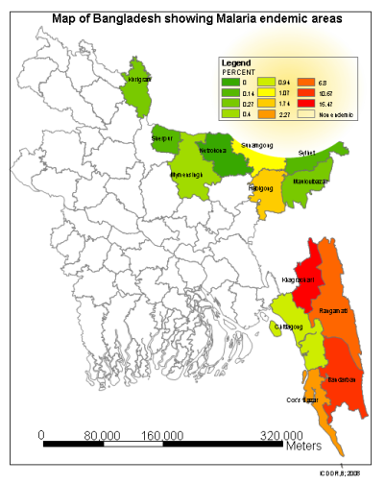
A substantial number of Matlab out-migrants moved to the Chittagong Hill Tracts where agricultural land was made available to Bengali farmers.
There is a village called ‘Matlab’.
Many of the local tribal land owners were displaced by this program, and formed resistance groups (“Shanti Bahini”).
Notes:
Concerns about the “slash and burn” or Jhum agriculture practised by the local tribal communities. This produces pools of stagnant water, ideal for mosquito breeding.
We are trying to develop a project to determine if this Jhum agriculture is increasing the prevalence of vectors (mosquitoes).

Slide 15
ESPA Deltas: Ecosystem Services for Poverty Alleviation in SW Bangladesh
How will livelihoods in these areas be impacted by changes in the GBM Delta?

Slide 16
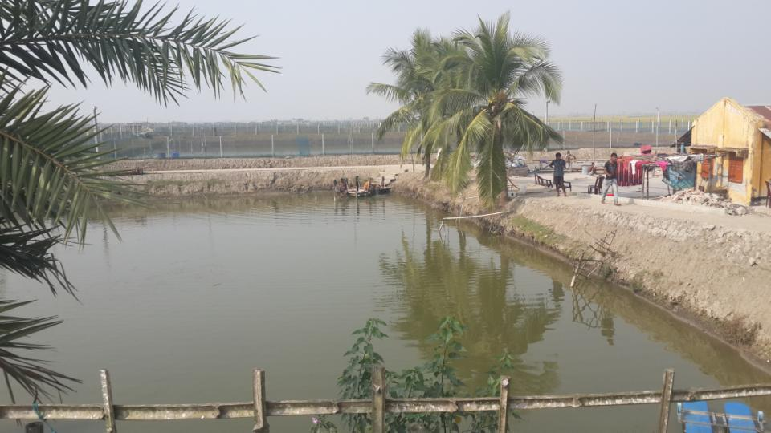
Dacope – shift from rice production to large scale shrimp production. Salinity causing loss of land suitable for rice. Some ‘political’ aspects of this shift

Slide 18
Rates of in- and out-migrations by sex and age, Matlab HDSS ,2013

