Slide 1
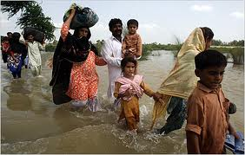
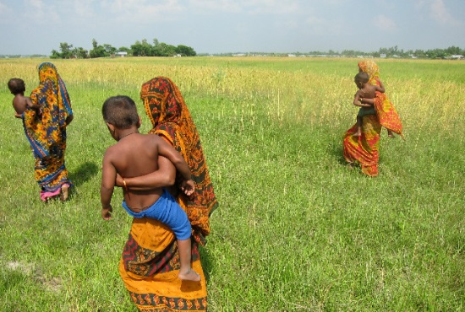
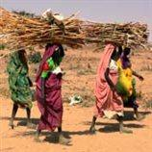
Clarification of Concepts and Legal Frameworks
Prof. Walter Kälin, Envoy of the Chairmanship of the Nansen Initiative
Khulna, 2 April 2015
The Nansen Initiative is primarily funded by the governments of Norway and Switzerland. The Initiative also benefits from generous funding from the European Commission and Germany .

Slide 2
Types of movements
Displacement = forced movement / internal or cross-border
Migration = (predominantly) voluntary movement / internal or cross-border / temporary – circular – permanent
Migration as adaptation = the predominantly voluntary decision to “avoid or adjust to” deteriorating environmental changes that could otherwise result in a humanitarian crisis and displacement in the future

Slide 3
Relocation = planned permanent movement of communities [evacuation = temporary]:
Preventive or reactive
Voluntary or forced
Internal or cross-border
Combinations: e.g. internal displacement followed by temporary cross-border migration pending reconstruction

Slide 4
Displacement
Category | Protection Framework
Internal displacement | Guiding Principles on Internal Displacement Domestic IDP laws and policies
Cross-border displacement | No normative framework (Refugee Convention not applicable; exceptions?)
Trafficking | Palermo Protocol, SAARC Convention

Slide 5
Migration
Category | Protection Framework
Internal migration | Constitution / human rights
Cross-border migration | Convention on the rights of migrant workers / (general) human rights: BUT: no right to admission, except bilateral / regional agreements

Slide 6
Relocation
Category | Protection Framework
Internal relocation | Human rights, domestic law UNHCR guidelines?
Cross-border migration | Bilateral agreements, human rights

Slide 7
Combined movements
Category | Protection Framework
Internal displacement => internal migration | = Guiding Principles/IDP policies = Constitution, domestic laws
Internal displacement => cross-border displacement | = Guiding Principles = ??
Internal displacement => Cross-border migration | = Guiding Principles = Migrant Workers Convention
Internal displacement => trafficking | = Guiding Principles = Palermo Protocol

