Slide 1
The CHS: is these appropriate for Both international and national actors?
Why and Why Not
Rezaul Karim Chowdhury
www.coastbd.net www.near.ngo

Slide 2
Interesting Indeed ??? But I need to tell about COAST involvement
6 years in HAP governance
Certified two times
Involved in CHS development as a technical committee member

Slide 3
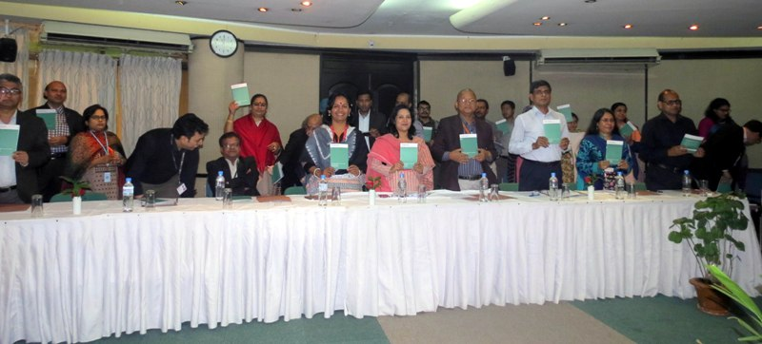
Interesting Indeed ??? But I need to tell about COAST involvement
In Bangladesh facilitated inclusive process of translation and multiplication.
Two year long process of translation, validation and lunching,
Aiming to make aware and to motivate to implement.
But, experience are different, observation in Cyclone Roanu (May 2016, Bangladesh) relief and rehabilitation work

Slide 4
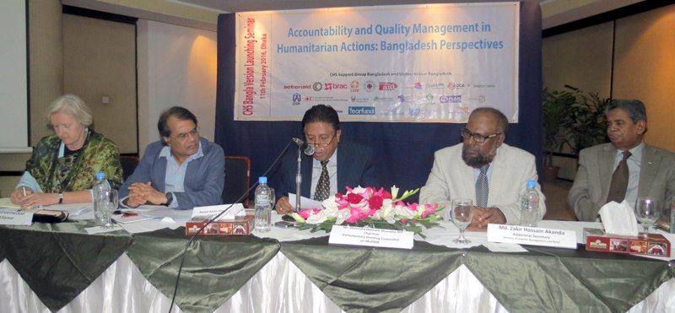
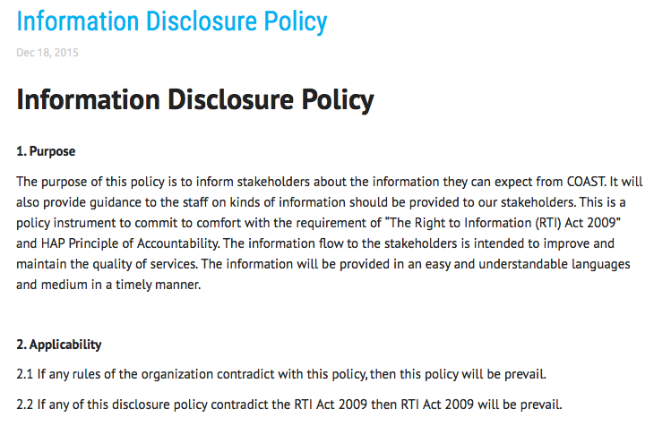
Why COAST have internalized it
Self-motivation and for
Mutual accountability
Respect from all level
Front line and public monitoring
Community and front line take responsibility
Low level of risk
People centered but staff managed
Visible Outcome
Reward and recognition are secondary

Slide 5
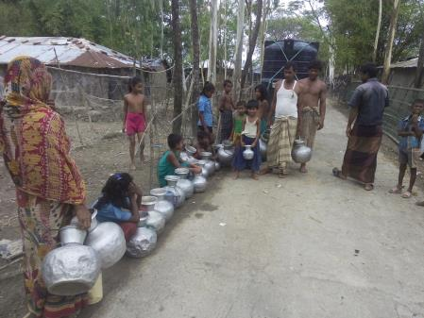
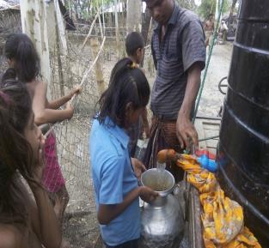
Experiences on cyclone Roanu (May 2016) relief rehabilitation work
After ”survival food package” distribution, we start talk with community especially with women, elderly people, children and population living in remote area, basically with two major objectives
To make the activities need based
To avoid duplication of resources.

Slide 6
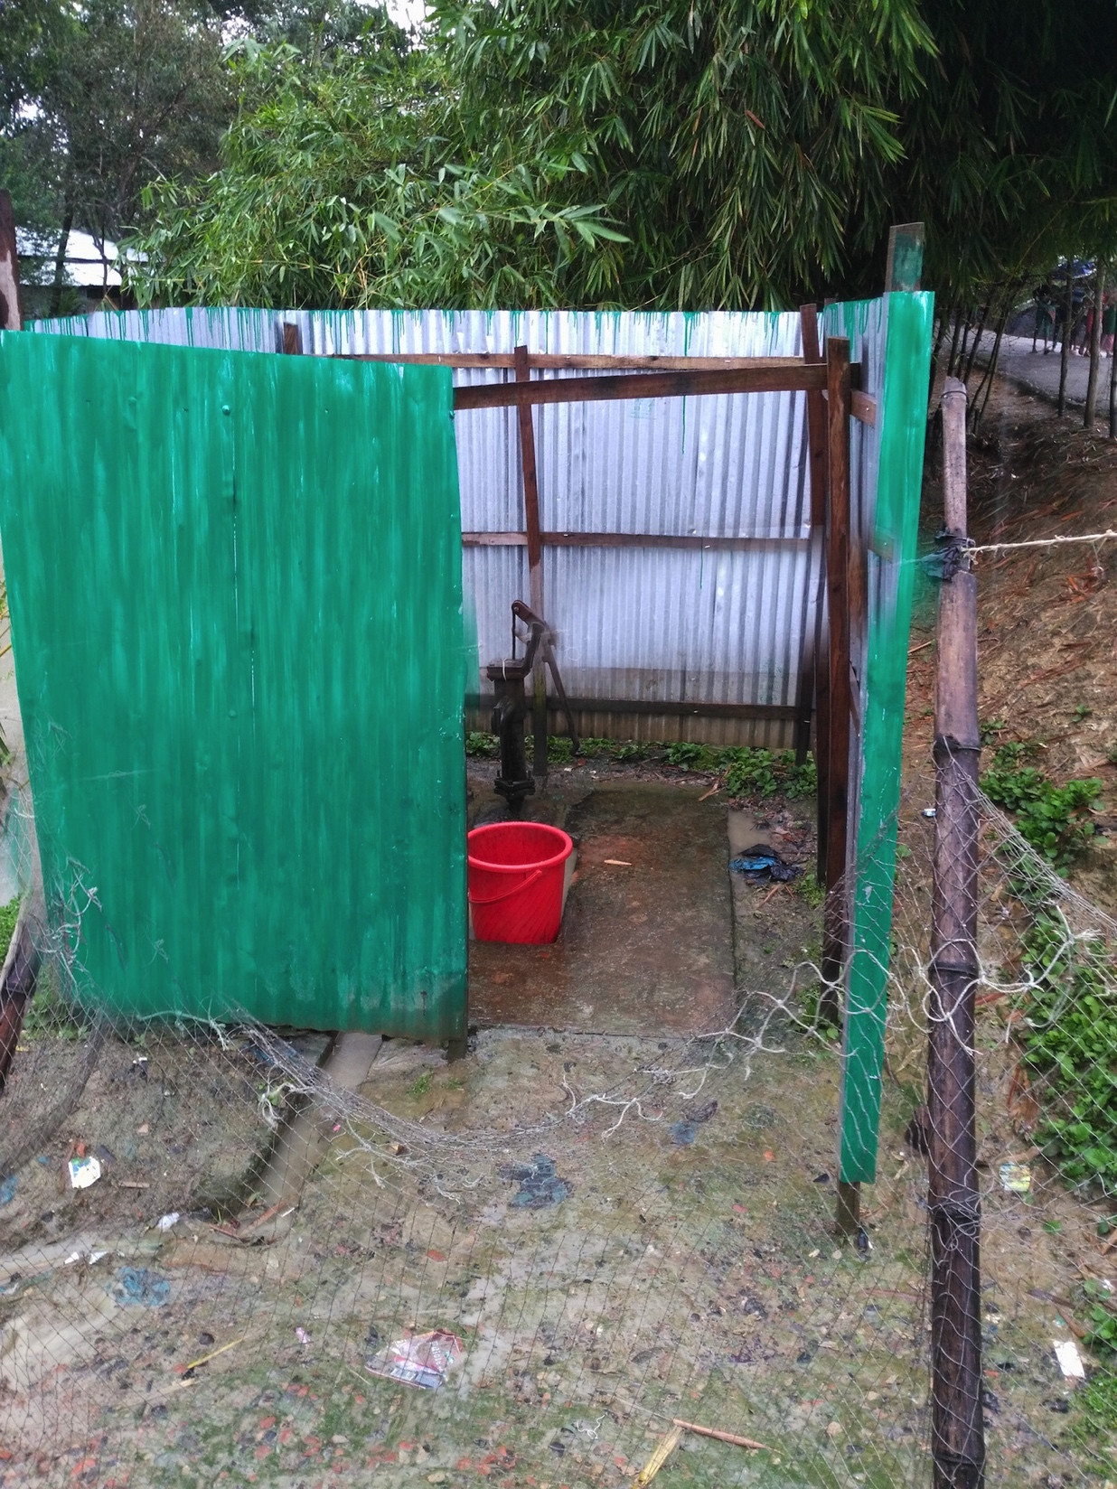
Experiences on cyclone Roanu (May 2016) relief rehabilitation work
We found that, involved with water sanitation (e.g., Cleaned water supply though machines, renovation of tub wells, increase surface water preservation through pond reaccavation, desalinization of pond, dress and book supply to the children, created cube surrounding tub wells to facilitate women to use those, reconstruct high raised toilets) and

Slide 7
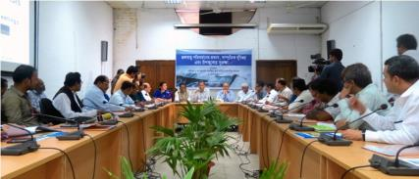
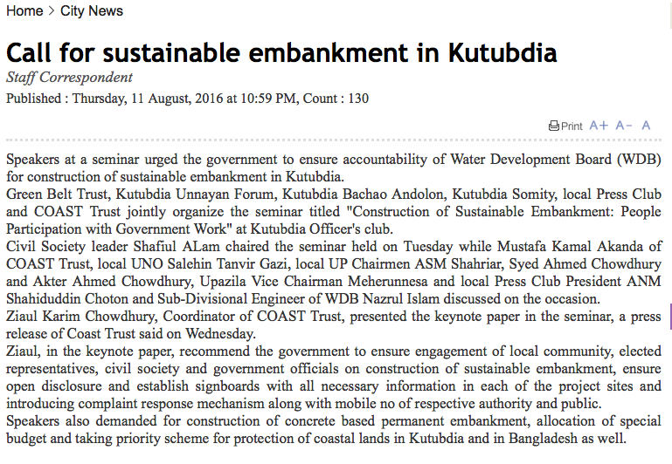
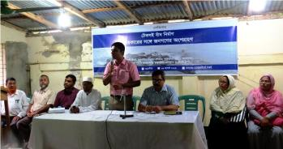
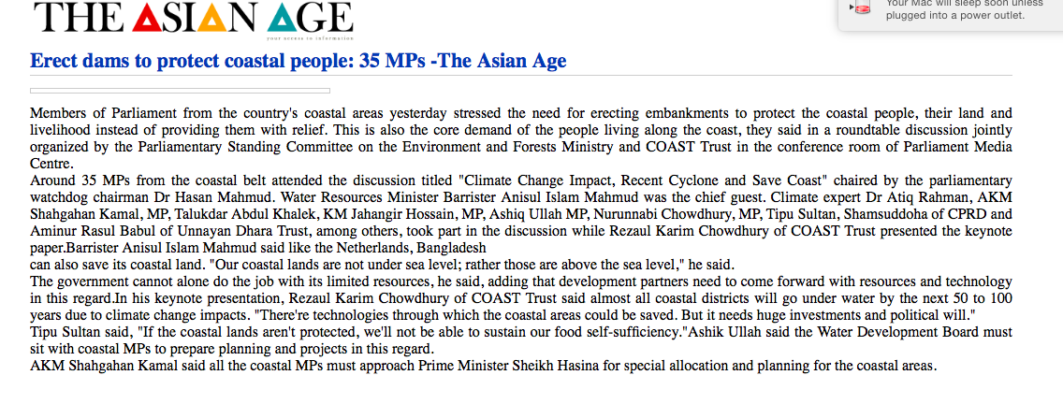
Experiences on cyclone Roanu (May 2016) relief rehabilitation work
local to national level advocacy (e.g., four rally in local and district level to demand immediate embankment constructions to protect people from monsoon tidal surge in each fortnight, organized parliamentary caucus in parliament with Member of Parliaments and Ministers during budget session, organize multi stakeholder consultation in grass root to promote public participatory monitoring during embankment construction.)

Slide 8
Experiences on cyclone Roanu (May 2016) relief rehabilitation work
Ironically we hardly see any INGO and local / NGO has involved in such crucial humanitarian service delivery like water and sanitation, mostly of them overwhelmed with “cash distribution” and no one involved with humanitarian advocacy. Our analysis of WHY in this regard.
INGOs head quarter might does not have any CHS multiplication (role out) plan for their country offices,
Little of agency wise system on continuous and consistent “trial, error and strive for excellence” on CHS,

Slide 9
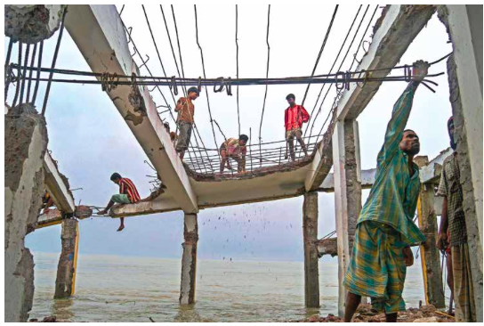
Experiences on cyclone Roanu (May 2016) relief rehabilitation work
Little on anything for partners in this regard, little of competition, mostly repetition of “sub-contracting approaches rather than partnership approach” mostly overwhelmed with humanitarian service delivery.
Little of no pressure or no review and reward from core donors like UKAID, ECHO, SIDA, NORAD and DANIDA.
Little of investment in demand side (ie, humanitarian victims and local and national NGOs are demanding Accountability / CHS) creation from front line / grass root.

Slide 10
It is not the question of appropriateness it is the question on operationalization of principles on our existence
WHY: we exist for poor / humanitarian victims, so there is a question of mutual accountability put them in place of decision making power.
WHAT: ultimate aim is to create environment that the state and the community will take responsibility own selves.

Slide 11
So here it is the matter of ...
Commitment, investment and multiplication process up to front line with trial and error process.
Competition policy among the partners based on internalization.
Core donor provide funding based on assessment of CHS multiplication and
Investment in respect of creating demand side of CHS.

Slide 12
Changes I propose
Annual reporting of membership in CHS on multiplication of CHS
Collection and dissemination of good practices and know how
Separate focal person in headquarter and separate allocation for CHS multiplication (role out)
Assessment by Core Donor on CHS multiplication prior to funding

